Slide 1
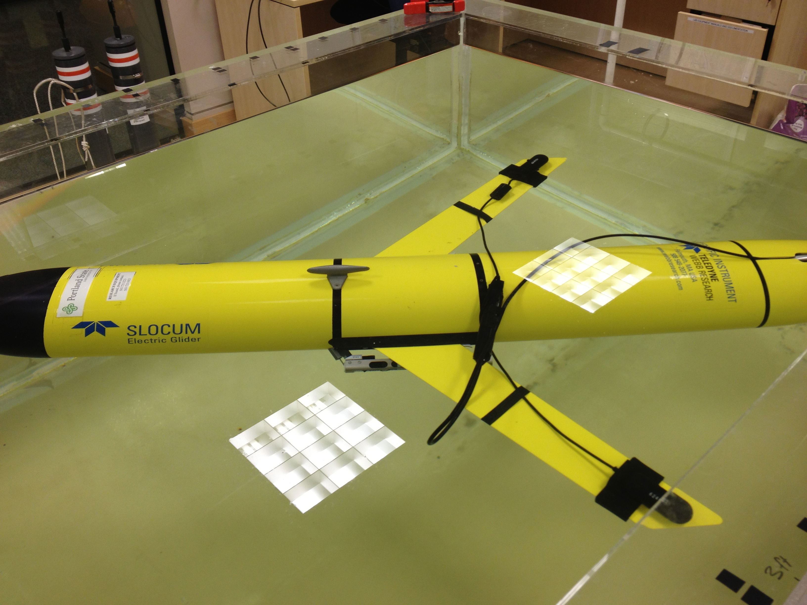
Capstone Proposal: Underwater Glider Audio Recorder
Sponsor: Metron, Dr. John Gebbie
Team Members: Chelsea Throop
Trevor Conant
Phu Nguyen
Saida Akhter

Slide 2
Concept
There is increased interest in using underwater gliders for marine mammal research and monitoring
NEAR-Lab Webb Slocum Glider has currently implemented an off the shelf recording device with two hydrophones
Our goal is to design additional software and hardware to improve the usability of the device

Slide 3
Project Goals
To improve current commercial audio recording device
Inexpensive device that includes a user interface
Records broadband signals over 30 days with up to 4 days of acoustic data
Includes hardware and software updates

Slide 4
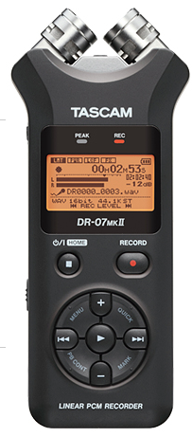
Hardware
Three major updates to hardware
Addition of a multiplexor to
interchange up to 4 SD cards
Separate Microcontroller unit
and Real Time Clock for complex
scheduled recordings
Button interface for hands-free schedule programming

Slide 5
Hardware- Data Storage
DSP on TASCAM (current off the shelf device) supports SDHC carts with FAT32 file format
32GB max on pre-formatted SDHC cards.
Multiple SD cards needed to meet storage requirements.
Requires multiplexing data bus to multiple devices
2x Fairchild FSSD06 multiplexer
Each MUX interfaces 2x micro SD cards each
4 micro SD cards total, 128GB combined total storage
Maximum power consumption for entire MUX system is <0.01 mW

Slide 6
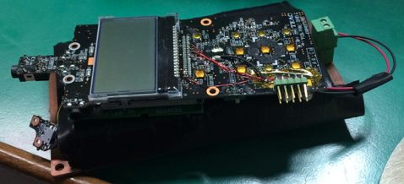
Hardware- Button interface
Must be able turn on and record with out manually pressing buttons
Requires connection to send electrical signals as if button sequence is being pressed

Slide 7
Hardware- RTC
A number of RTC (ISL12082, DS1307, PCF2127, M41T82/83, DS1337) was looked at before selecting one.
Any of these could be used but we picked PCF2127
Feasibility of communicating with the MCU
Power consumption
Temperature compensated
Operating range
I2C bus interface
Programmable watchdog timer with interrupt

Slide 8
Hardware- MCU
Several MPU were studied - 8-bit PIC MCUs, ATmega328p, PIC24F16KA101. All these are extreme low power Microcontrollers.
Among them 8-bit PIC MCU looked most suitable.
128KB Flash, 4KB RAM, Onboard EEPROM,
I2C, SPI, UART, USB, Ethernet
Operation down to 1.8V, sleep current as low as 20nA
Special low power BOR, WDT, RTC
Programmable Switch Mode Controller
Industry’s most robust offering

Slide 9
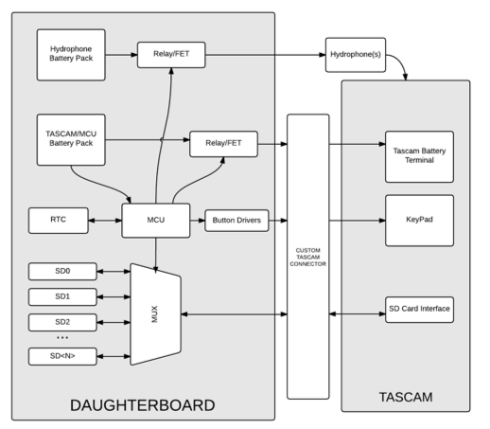
Hardware- Block Diagram

Slide 10
Software
Three major components of software
Pre-Mission user interface
In-Mission recording schedule control
Post-Mission data analysis

Slide 11
Software- Pre-Mission
User interface : command line or GUI
Allow user to program the schedule by inputting:
recording and stand-by interval
sample rate
delay for start
Confirm the schedule if the inputs are “good”
Estimate maximum operation time of the system
Set the operation parameters for the system

Slide 12
Software- In-Mission
Control the operation as per programed schedule
Manage the data storage
Store data to SD card
Switch to the next available SD card when existing card “full”
Reset power of “mainboard” to direct the data to targeted SD card

Slide 13
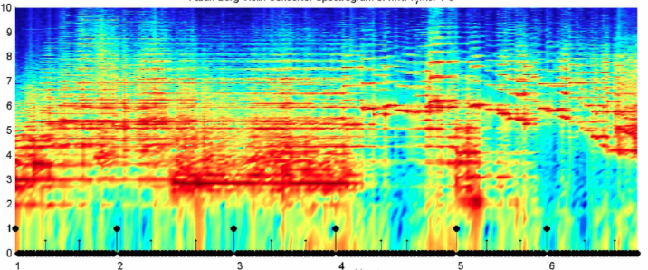
Software- Post- Mission
Display list of audio files
Allow user to playback the records
Display the spectrogram and plots for analysis

Slide 14
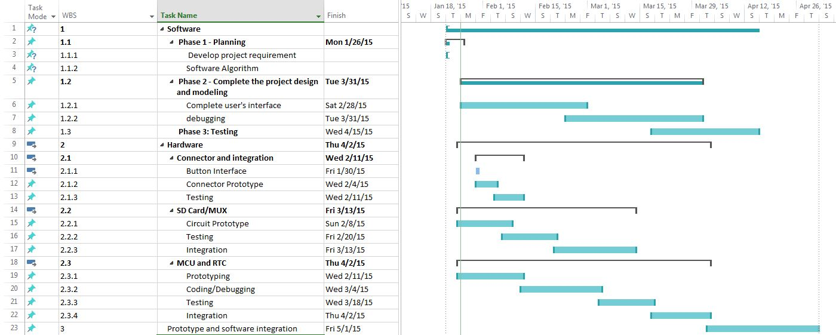
Schedule

